Slide 1

Risk
Management

Slide 2
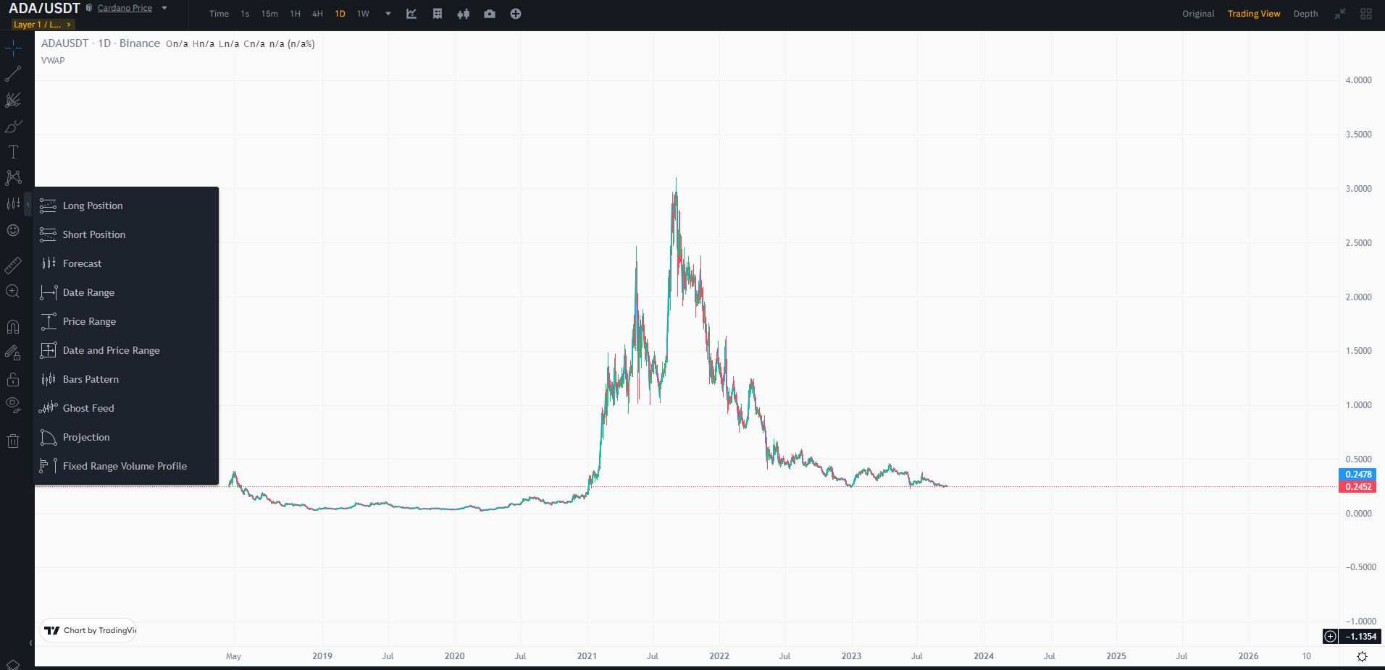
Positions
Long Position
Short Position

Slide 3
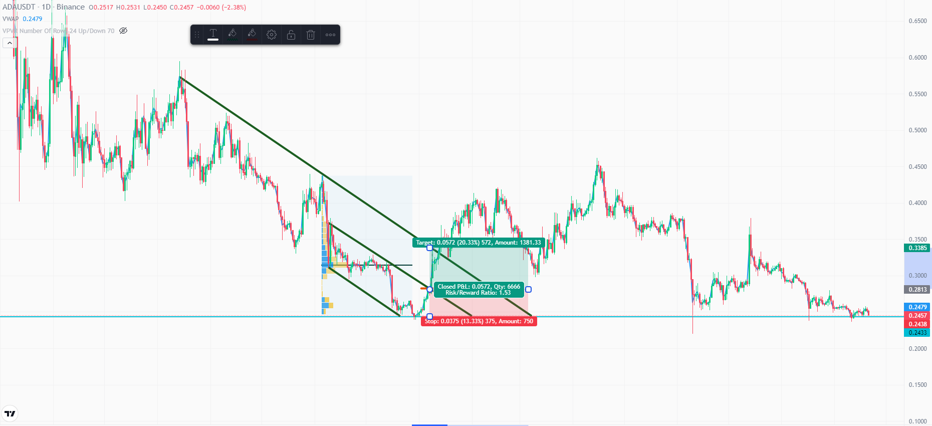
Long Position

Slide 4
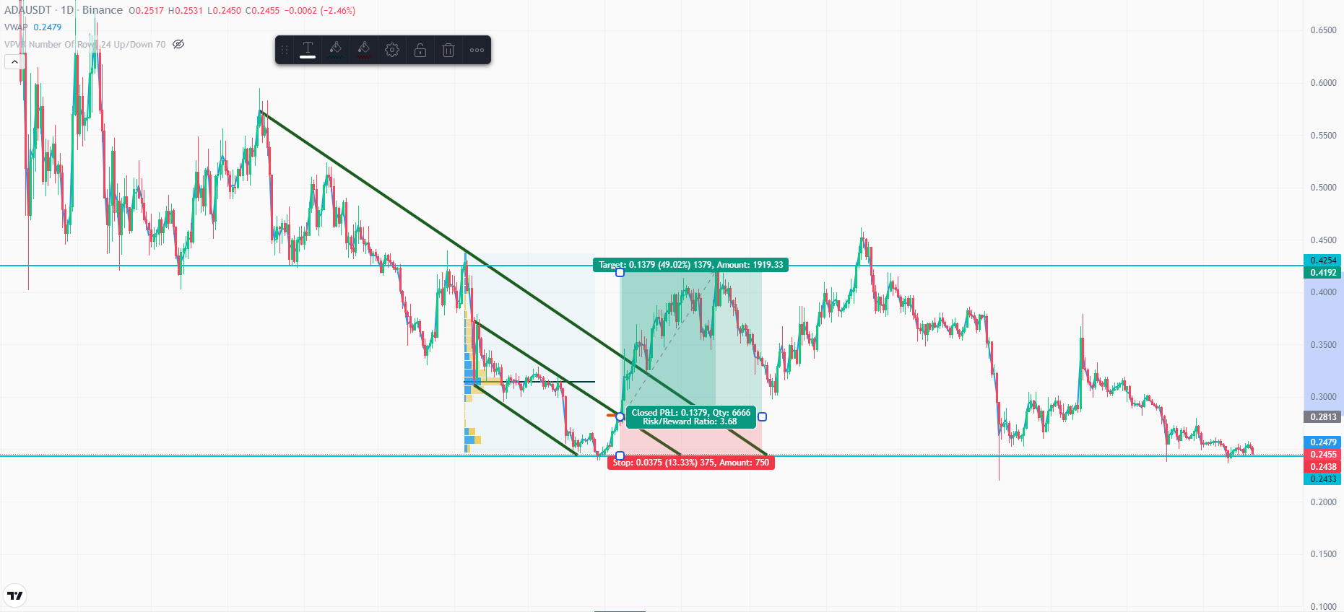
Long Position

Slide 5
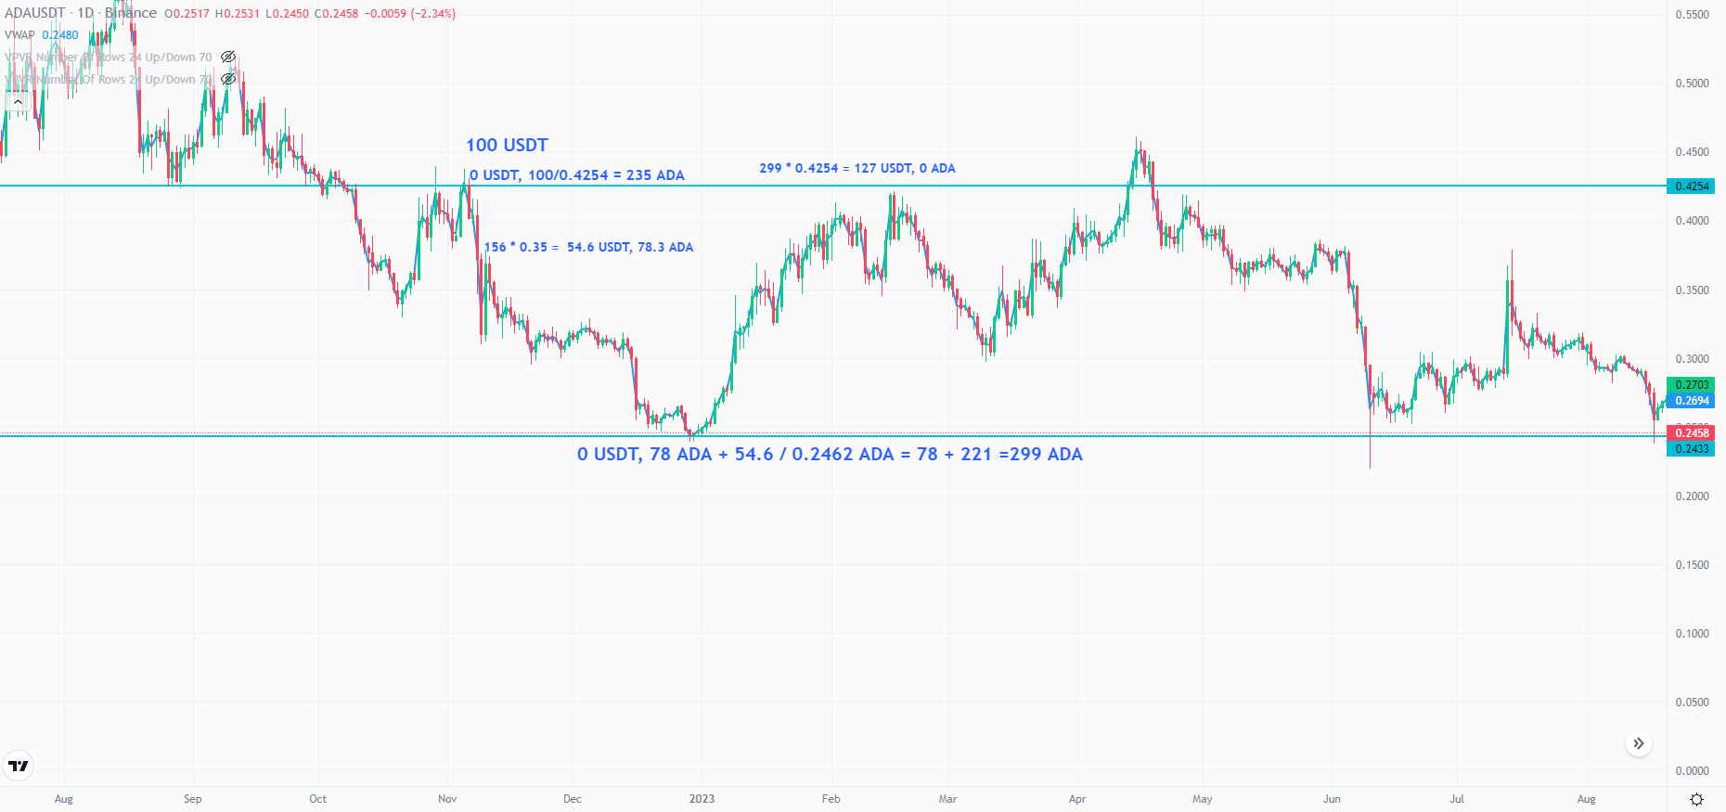
Short Position

Slide 6
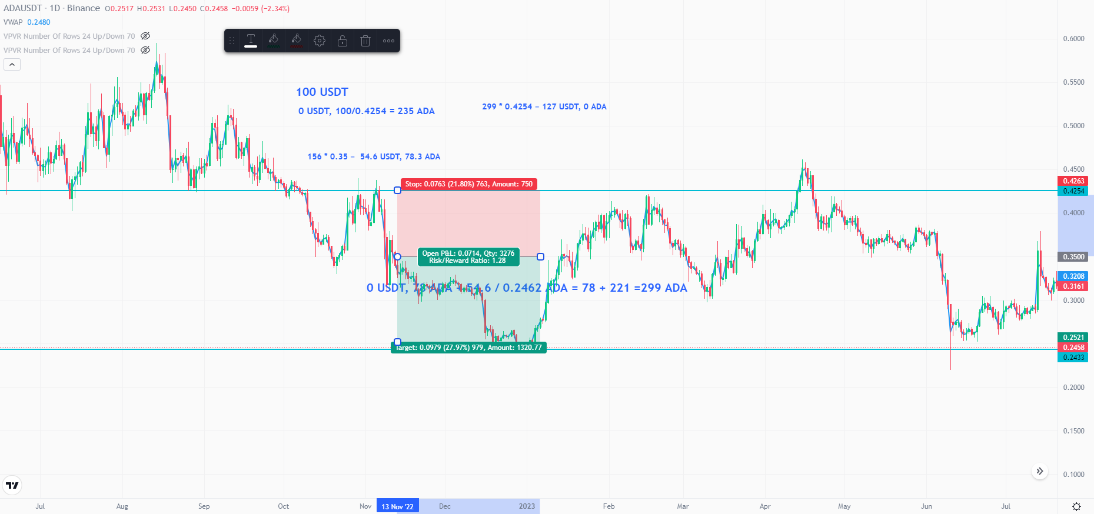
Short Position

Slide 7
Key Considerations
Risk to Reward
POS Size
Passive Entry

Slide 8
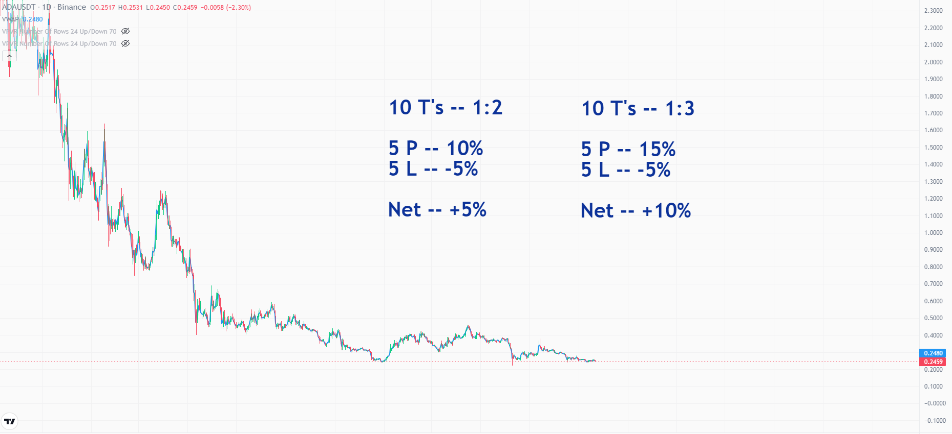
Risk to Reward
Notes:
See Saw toward loss, so wait

Slide 9
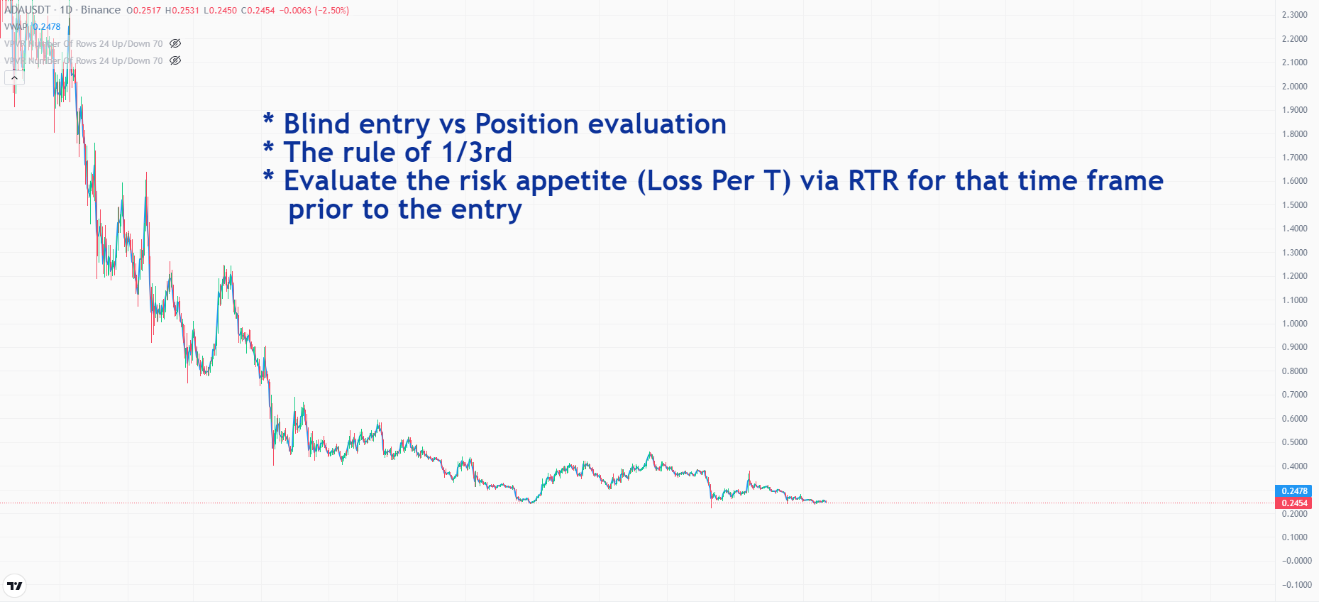
Position Size

Slide 10
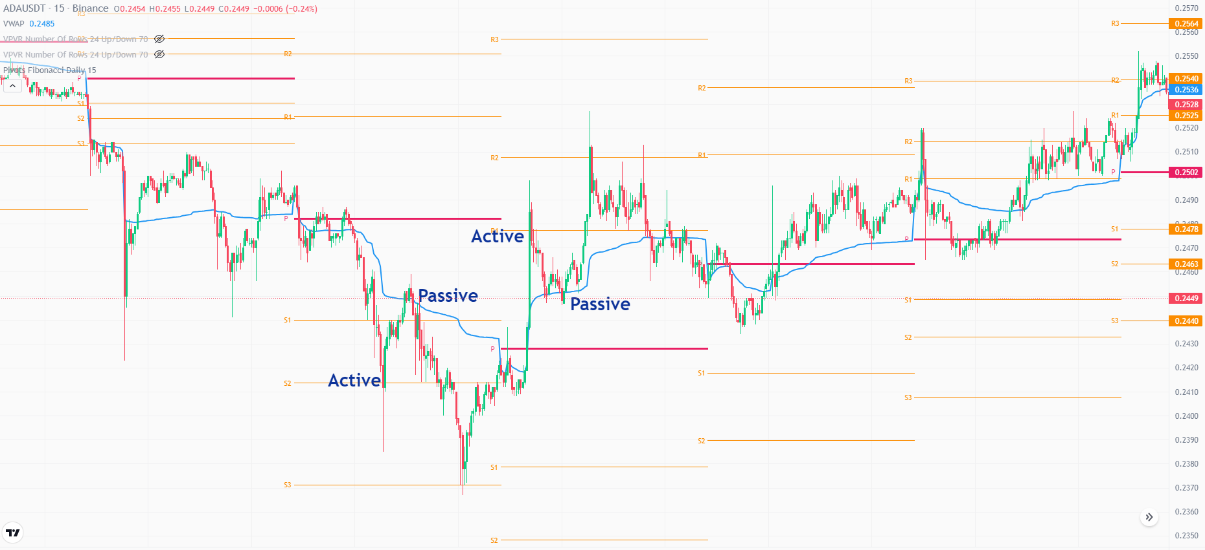
Passive Entry

Slide 11
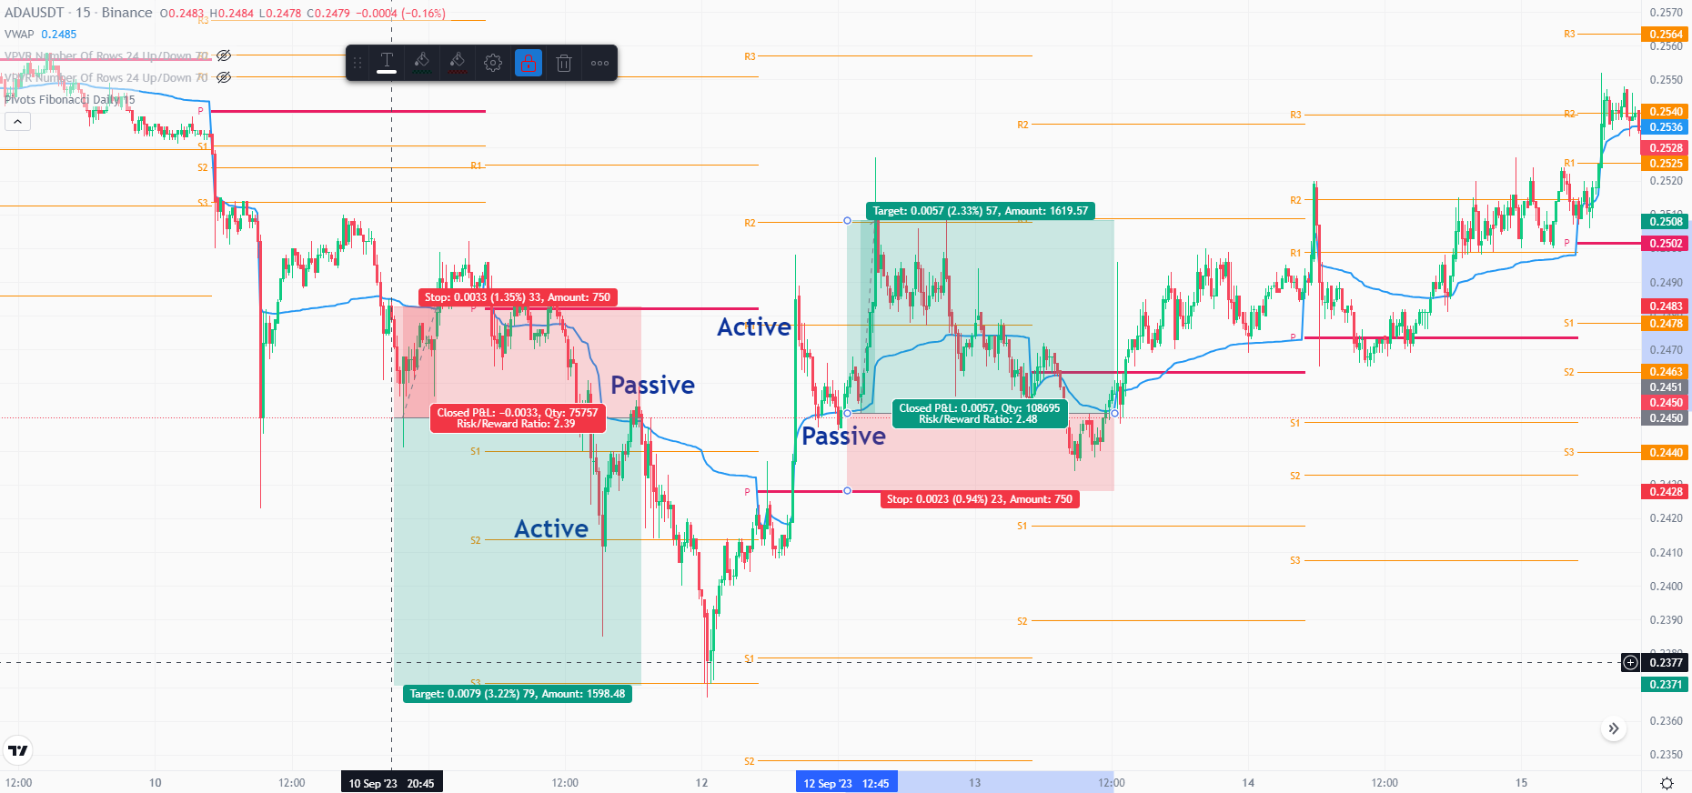
Passive Entry

